Slide 1

Project: Anime Analytics Data Pipeline Data Engineering Portfolio Project
Demonstrating SQL proficiency and ETL pipeline development through a complete data engineering solution.

Slide 2
Project Overview
Objective
Build a complete data engineering solution demonstrating SQL proficiency and ETL pipeline development with real-world anime recommendation data.
Dataset Highlights
12,294 anime records spanning multiple genres and formats.
50,000+ user ratings providing rich analytical insights.
Complex data relationships enabling advanced query patterns.
Key Components
SQL Analysis & Complex Queries
Automated ETL Pipeline
Cloud Storage Integration
Interactive Dashboard

Slide 3





System Architecture
Data Sources
CSV files containing anime records and user ratings.
ETL Pipeline
Extract, Transform, and Validate data with quality checks.
Oracle Database
Structured storage with optimised schema design.
Dashboard
Interactive Streamlit visualization and monitoring.
The architecture ensures data quality through automated validation, maintains data integrity with comprehensive error handling, and provides cloud backup for disaster recovery.

Slide 4
Technologies Stack
Database Layer
Programming
Oracle Database XE for enterprise-grade data storage with ACID compliance.
Python 3.8+ with Pandas, OracleDb, and Streamlit libraries.
ETL Framework
Cloud & Storage
Custom Python pipeline with robust error handling, logging, and validation.
Implemented a local file system that simulates AWS S3/Azure Blob storage with organised buckets, versioned backups, and comprehensive metadata tracking.

Slide 5


SQL Analysis Excellence
Complex Queries
Implemented
JOIN Operations (INNER, LEFT) for multi-table analysis.
Aggregate Functions with GROUP BY/HAVING clauses.
CTEs (Common Table Expressions) for readable queries.
Full CRUD Operations with data integrity checks.
Advanced Filtering & Sorting with Subqueries.
Key Insights Discovered
Highest Rated: "Kimi no Na wa.“ achieving 9.82/10.
Most Common Format: TV Shows (3,671 anime).
Genre distribution revealing viewer preferences.
Rating correlations across categories and time periods.

Slide 6
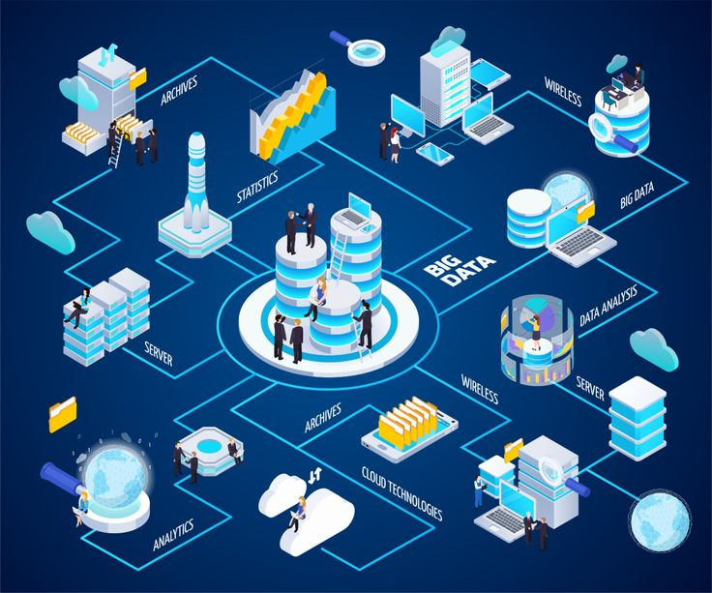
ETL Pipeline Design
EXTRACT
Source: Raw CSV files.
12K+ anime records.
50K+ user ratings.
Initial validation & sampling.
TRANSFORM
Clean null values & invalid entries.
Create business metrics.
Add quality flags.
Standardize data types.
LOAD
Oracle database storage.
Staging tables with validation.
Automated cloud backups.
Metadata tracking.
KEY FEATURES
Modular & fault-tolerant design.
Data quality verification.
Comprehensive logging.
Production-ready structure.

Slide 7
Overcoming Technical Challenges
Database Connection Issues
Data Quality Assurance
Implemented robust connection handling with automatic error recovery, connection pooling, and timeout management to ensure reliability.
Built comprehensive validation checks including range verification, null handling, and duplicate detection with detailed data cleaning procedures.
Unicode/Encoding Problems
Pipeline Monitoring
Standardized text handling across the pipeline,
Implemented UTF-8 encoding, and removed problematic characters to support international anime titles.
Implemented detailed logging system with status tracking, performance metrics, and alert notifications for proactive issue resolution.

Slide 8

Results & Business Value
50k+
Records
Processed
Pipeline efficiently handles large-scale data operations.
100%
Data Integrity
No critical data quality
issues in production.
3
Data Source
Unified view across
multiple data streams.
Business Impact
Created a robust foundation for anime recommendation systems with scalable architecture supporting future growth. The repeatable ETL process enables rapid deployment for similar projects, while optimized SQL queries deliver insights in seconds rather than minutes.

Slide 9
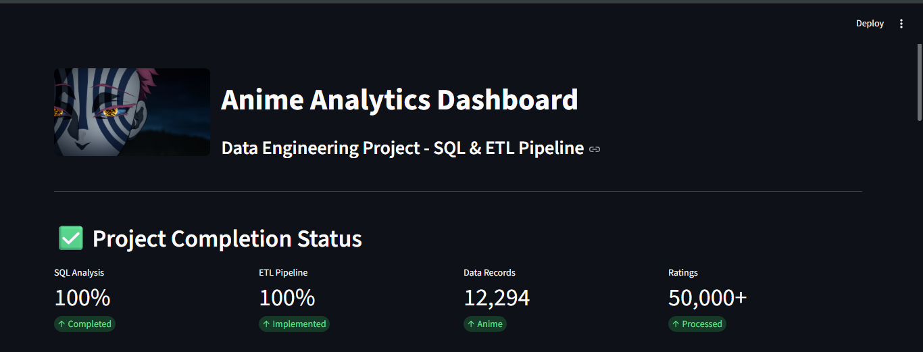
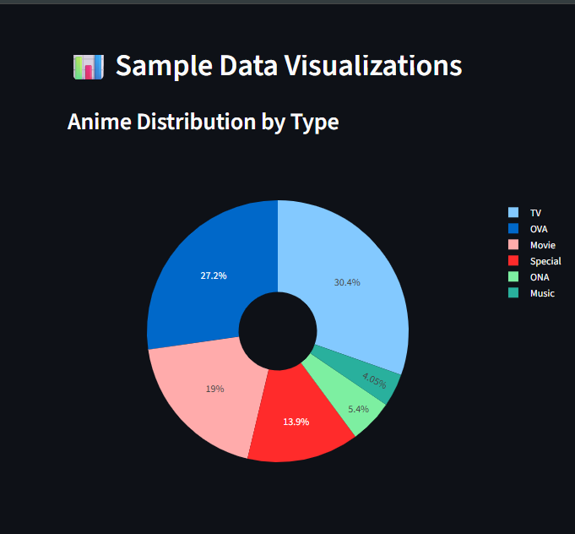
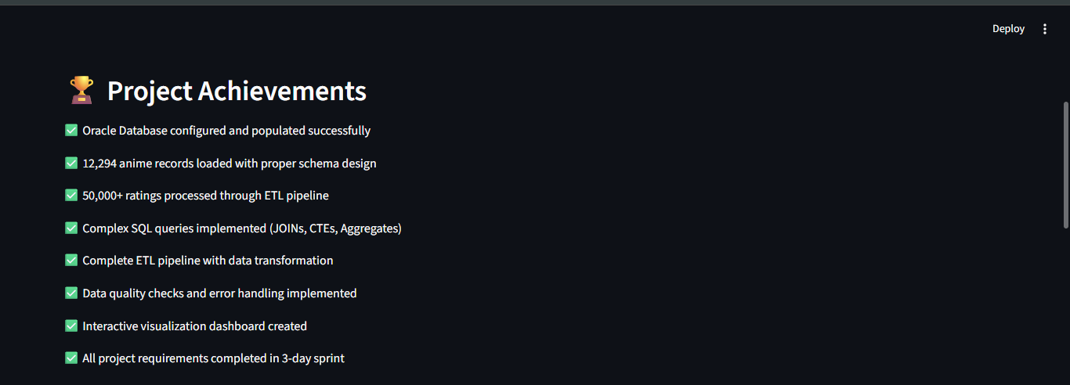
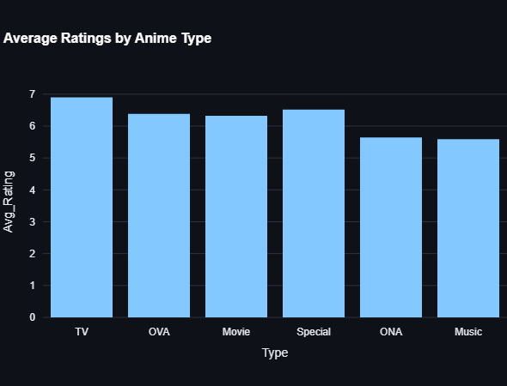
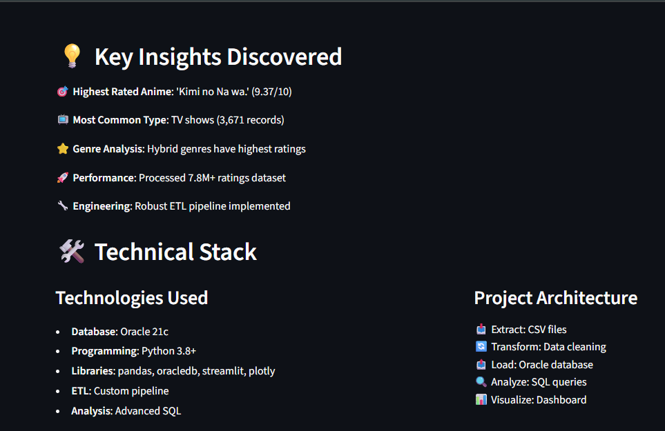
Live System Demonstration
Anime Data Models

Slide 10
Skills Demonstrated & Future Vision
Technical Skills Acquired
SQL Mastery: Query optimization, complex joins, CTEs, and performance tuning.
ETL Engineering: Automated data pipelines with quality validation frameworks.
Cloud Integration: AWS S3/Azure Blob Storage for data persistence.
Data Visualization: Interactive dashboards using Streamlit.
Python Development: Pandas, OracleDB, and data processing libraries.
Career Impact
This project serves as a compelling portfolio piece demonstrating full-stack data engineering expertise, from raw data ingestion through cloud deployment and visualization.
Future Enhancements
Short-term goals:
Deploy to AWS/Azure cloud platform.
Implement Airflow for pipeline orchestration and monitoring.
Enhance dashboard with predictive analytics.
Long-term vision:
Real-time data streaming with Apache Kafka.
Machine learning recommendation engine.
Containerization with Docker and Kubernetes.

Slide 11

Arigatō

